Slide 1
Clock pulse generator

Slide 2
Astable Multivibrator Mode of 555 Timer IC
Astable multivibrator is also called as Free Running Multivibrator. It has no stable states and continuously switches between the two states without application of any external trigger. The IC 555 can be made to work as an astable multivibrator with the addition of three external components: two resistors (R_{A} and R_{B}) and a capacitor (C).

Slide 3
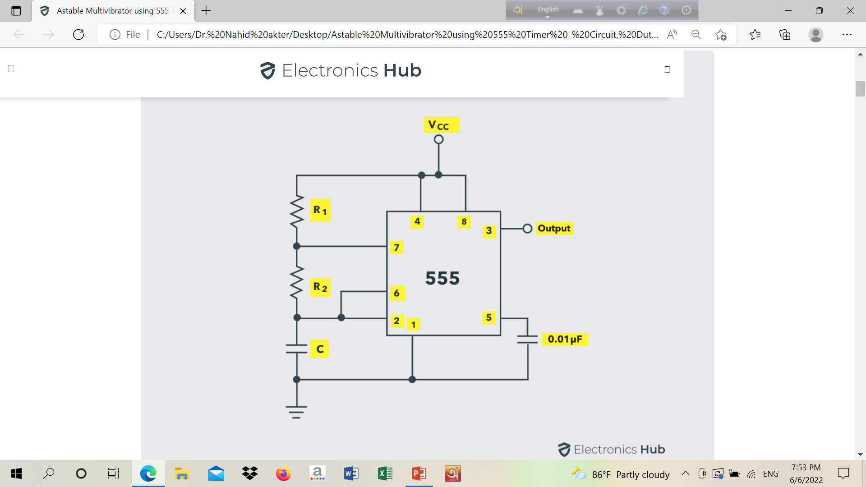
Astable Multivibrator Mode of 555 Timer IC

Slide 4
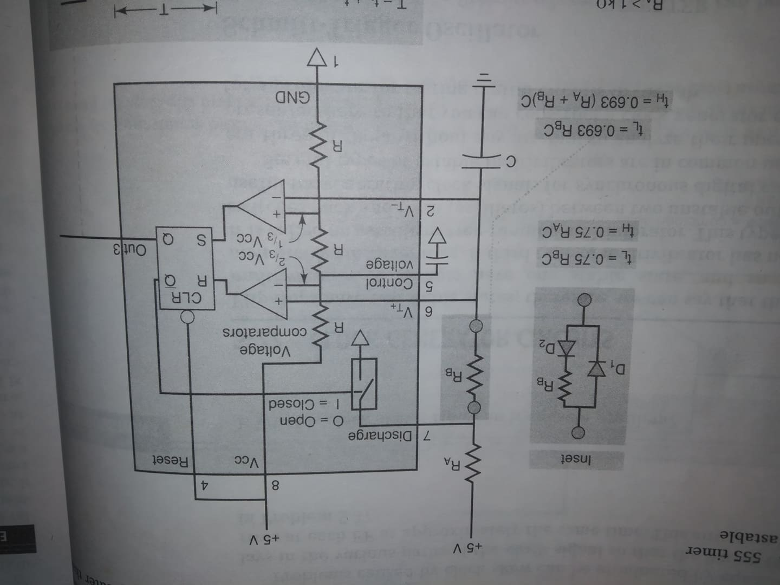
Astable Multivibrator Mode of 555 Timer IC

Slide 5

Astable Multivibrator Mode of 555 Timer IC
Initially, on power-up, the flip-flop is RESET (and hence the output of the timer is low). As a result, the discharge transistor is driven to saturation (as it is connected to $\overline{Q}$).The capacitor C of the timing circuit is connected at Pin 7 of the IC 555 and will discharge through the transistor. The output of the timer at this point is low. The voltage across the capacitor is nothing but the trigger voltage. So, while discharging, if the capacitor voltage becomes less than 1/3 V_{CC}, which is the reference voltage to trigger comparator (comparator 2), the output of the comparator 2 will become high. This will SET the flip-flop and hence the output of the timer at pin 3 goes to HIGH.

Slide 6
Astable Multivibrator Mode of 555 Timer IC
This high output will turn OFF the transistor. As a result, the capacitor C starts charging through the resistors R_{A} and R_{B}. Now, the capacitor voltage is same as the threshold voltage (as pin 6 is connected to the capacitor resistor junction). While charging, the capacitor voltage increases exponentially towards V_{CC} and the moment it crosses 2/3 V_{CC}, which is the reference voltage to threshold comparator (comparator 1), its output becomes high.
As a result, the flip-flop is RESET. The output of the timer falls to LOW. This low output will once again turn on the transistor which provides a discharge path to the capacitor. Hence the capacitor C will discharge through the resistor R_{B}. And hence the cycle continues.

Slide 7
Astable Multivibrator Mode of 555 Timer IC
Thus, when the capacitor is charging, the voltage across the capacitor rises exponentially and the output voltage at pin 3 is high. Similarly, when the capacitor is discharging, the voltage across the capacitor falls exponentially and the output voltage at pin 3 is low. The shape of the output waveform is a train of rectangular pulses.

Slide 8
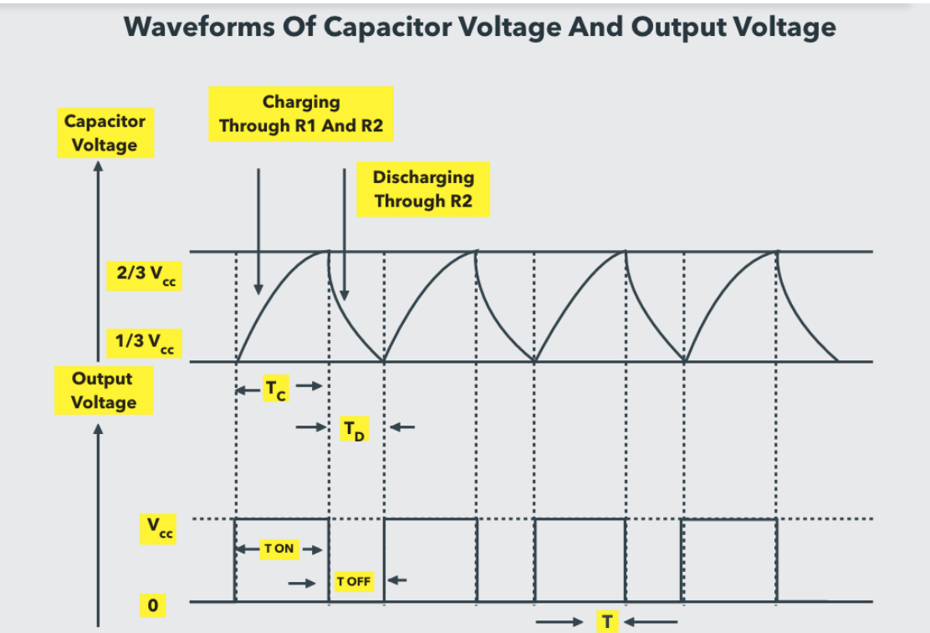
Astable Multivibrator Mode of 555 Timer IC

Slide 9
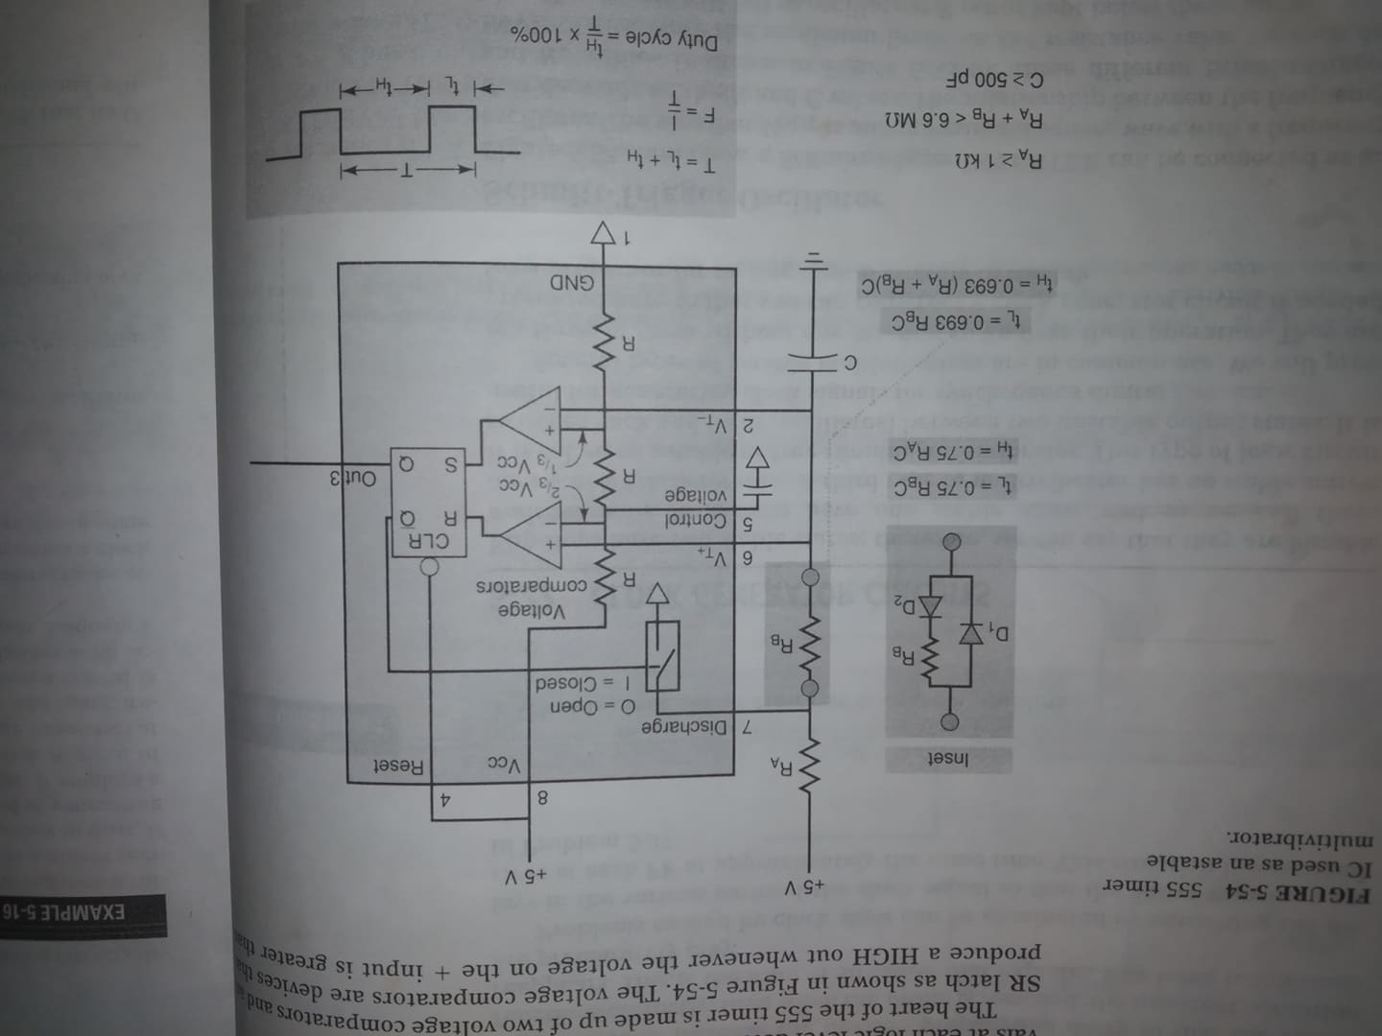
Astable Multivibrator Mode of 555 Timer IC

Slide 10
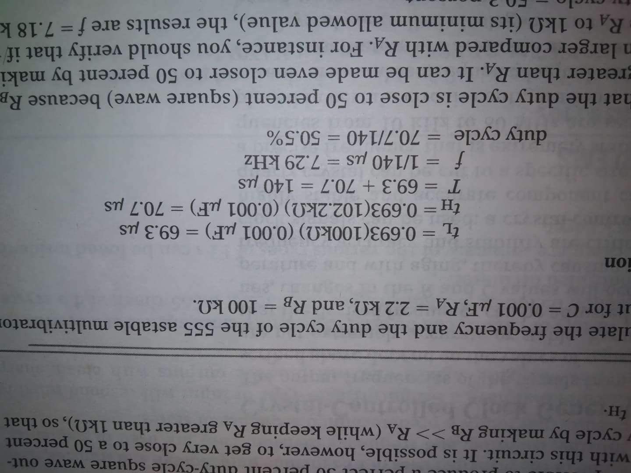

Example:
Calculate the frequency and the duty cycle of the 555 astable multivibrator output for C= 0.001 $μ$F, R_{A}= 2.2 k$Ω, RB=100$ k$Ω.$

Slide 11
Digital arithmetic: operation and circuits

Slide 12
Binary addition

Slide 13
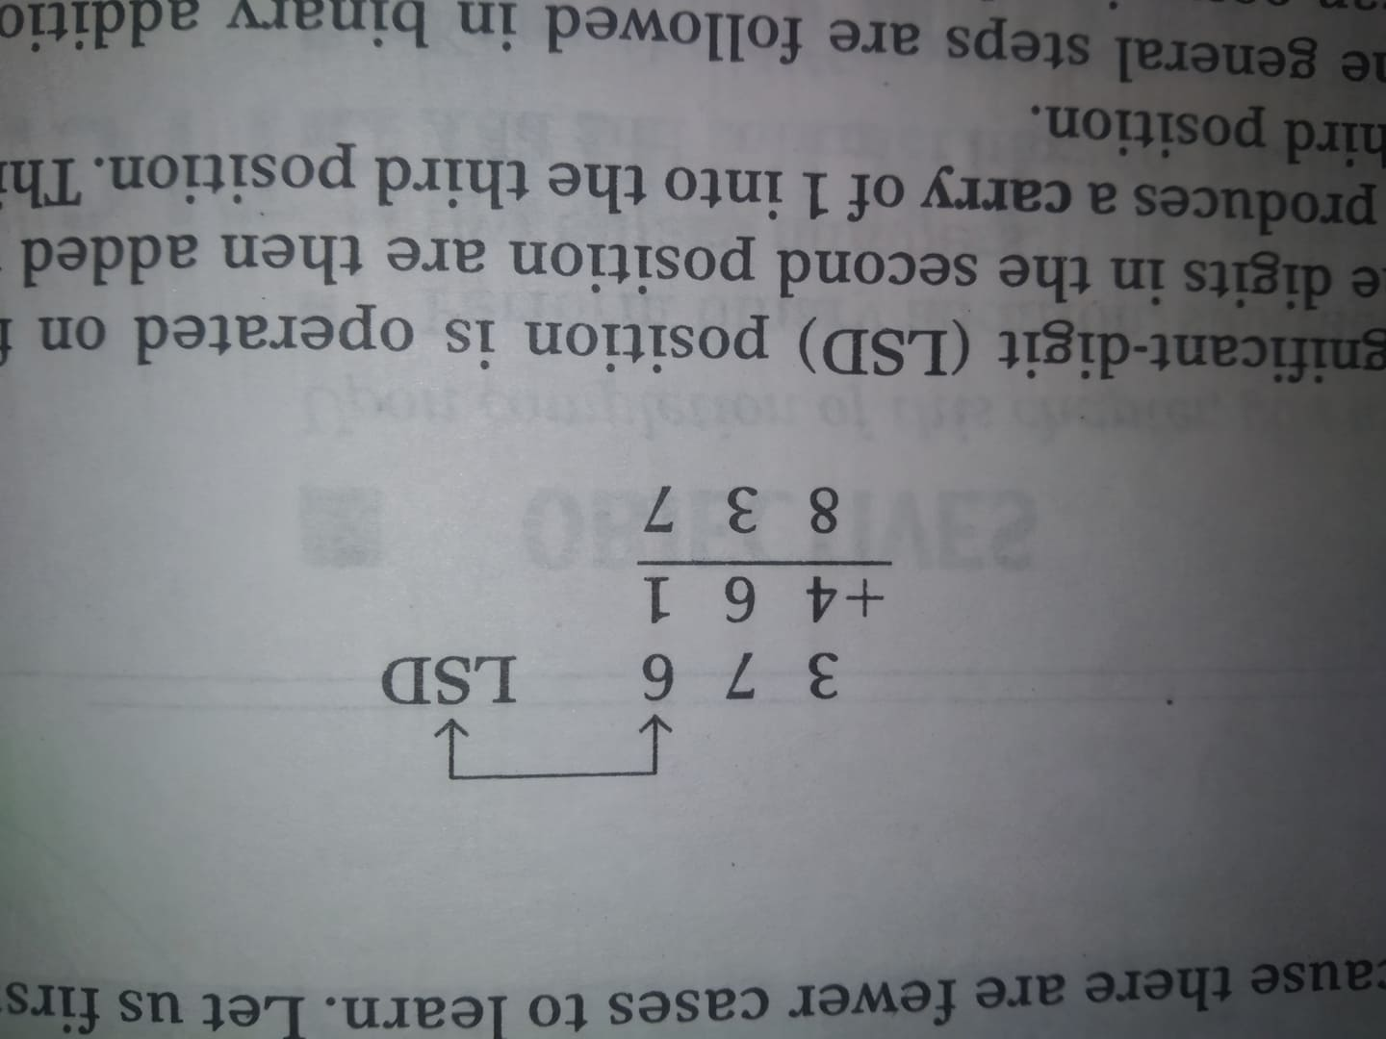
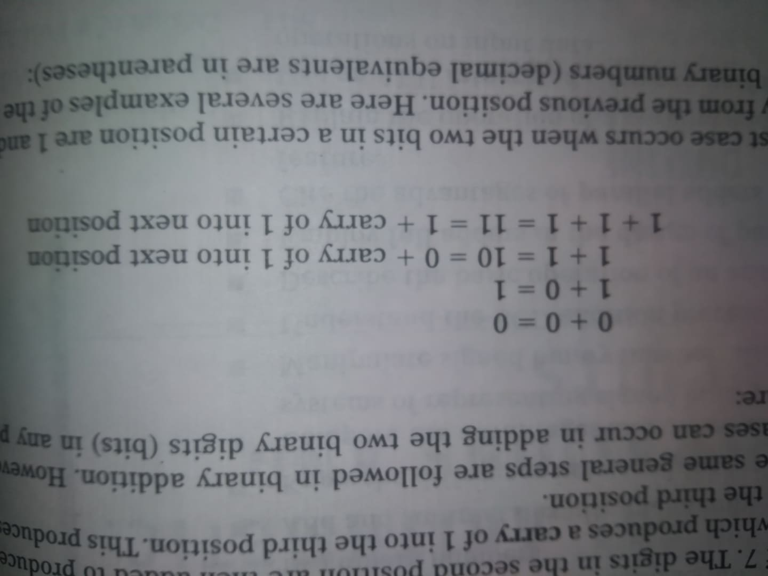
Binary addition
a. Decimal addition (sum, carry) b. General steps of binary addition.

Slide 14
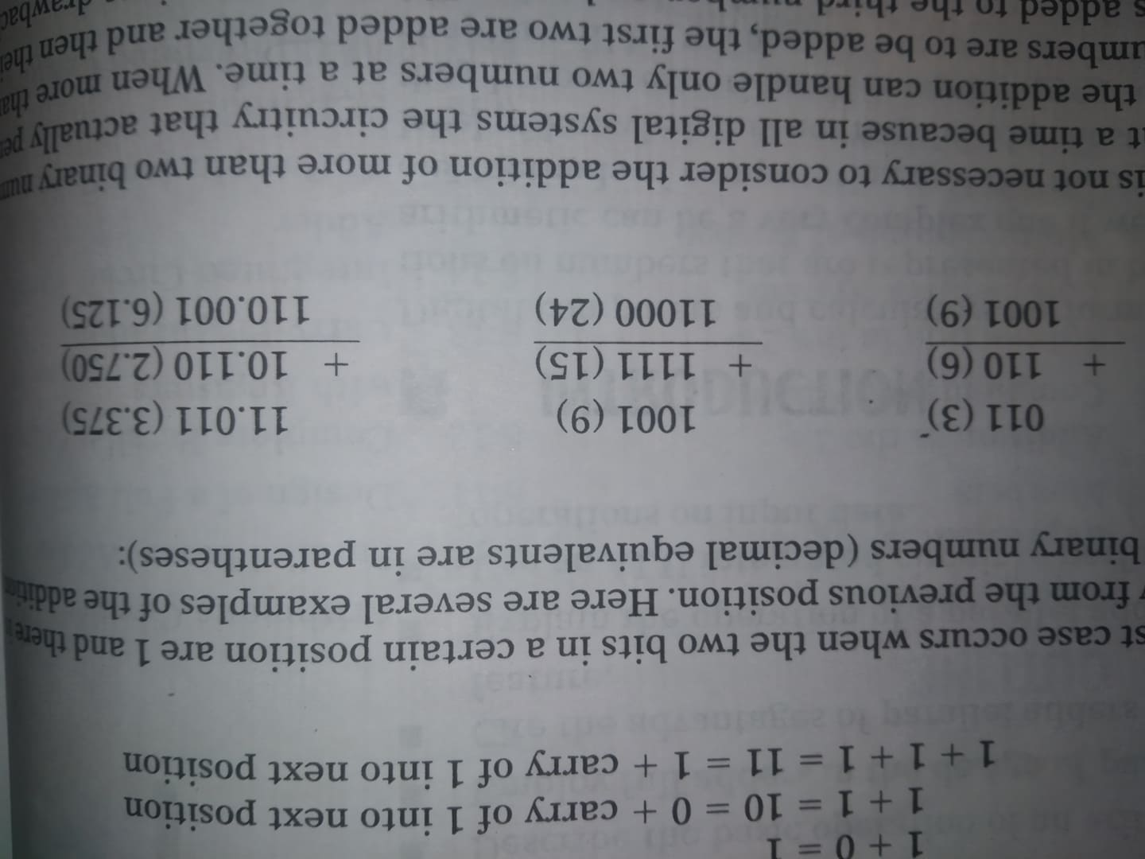
Examples

Slide 15
Representing signed number
In digital computers, binary numbers are represented by a set of binary storage devices (FFs). Each device represents one bit. Example: A six bit FF register can store binary numbers ranging from 000000-111111 (0-63 decimal). This represents the magnitude of the number.
Most digital computers and calculators handle negative as well as positive numbers, some means is required for representing the sign of the number (+ or -). This is usually done by adding to the number another bit called the sign bit. In general, 0 represents the positive number and 1 represents the negative number.

Slide 16
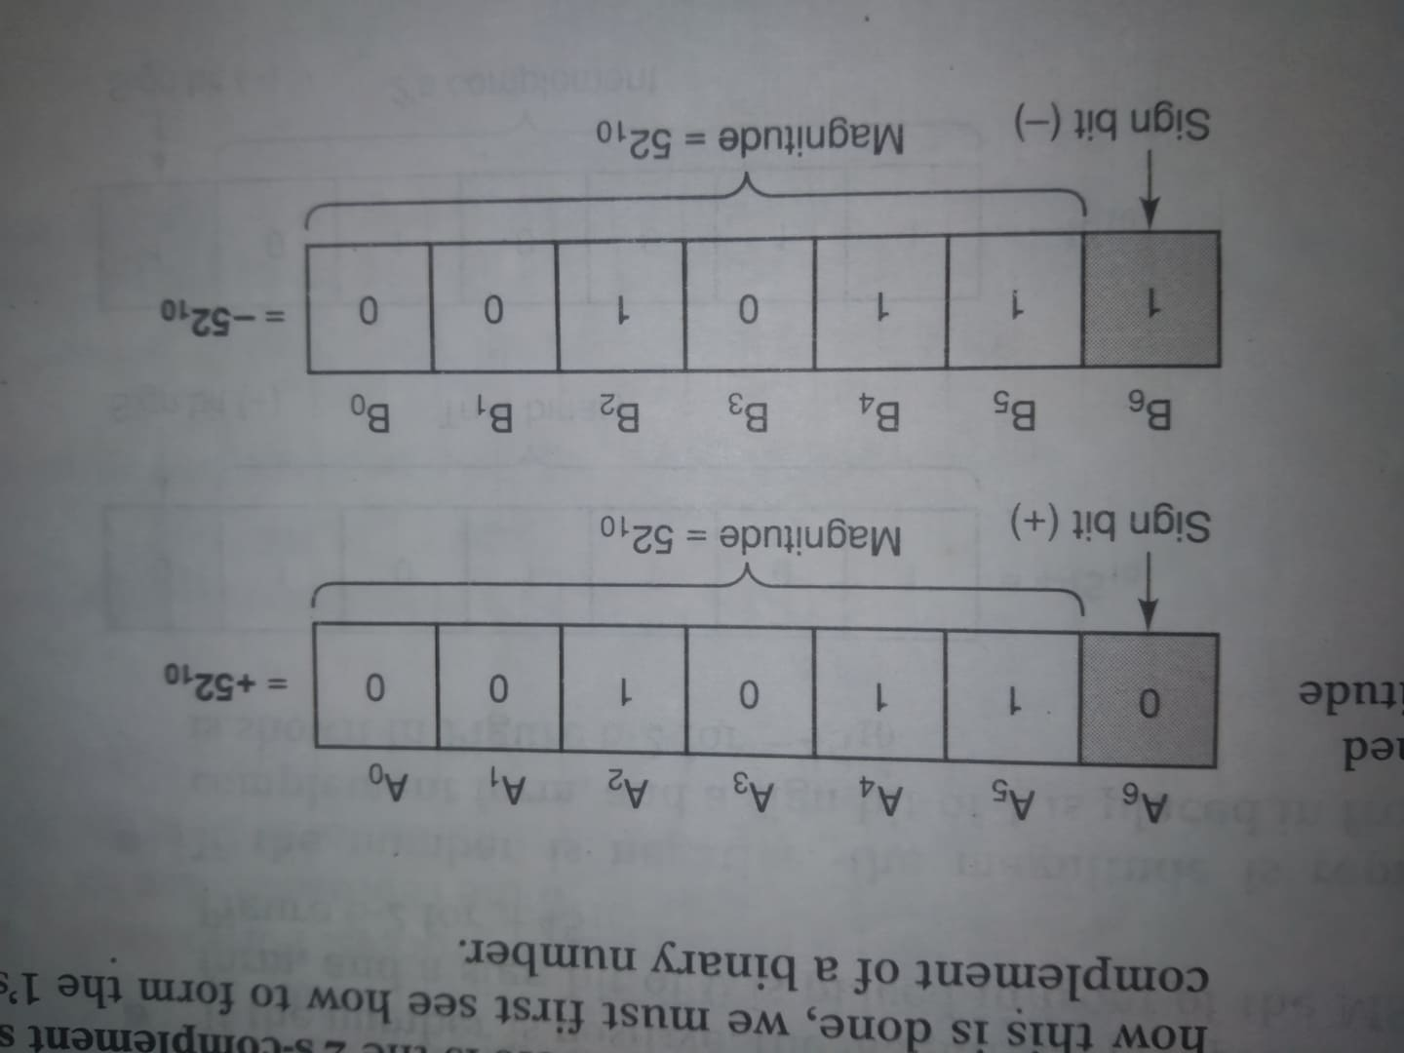
Representing signed number
Example: For a six bit number with sign number, the MSB represents sign bit and the rest bits represents the magnitude of the number.

Slide 17
1’s/2’s complement

Slide 18
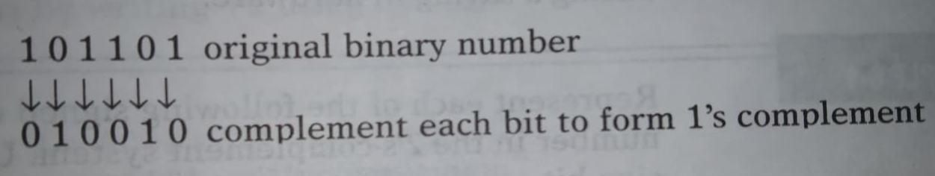
1’s complement form
The 1’s complement of a binary number is obtained by changing each 0 to a 1 and each 1 to a 0. In other words, change each bit in the number to it’s complement.

Slide 19
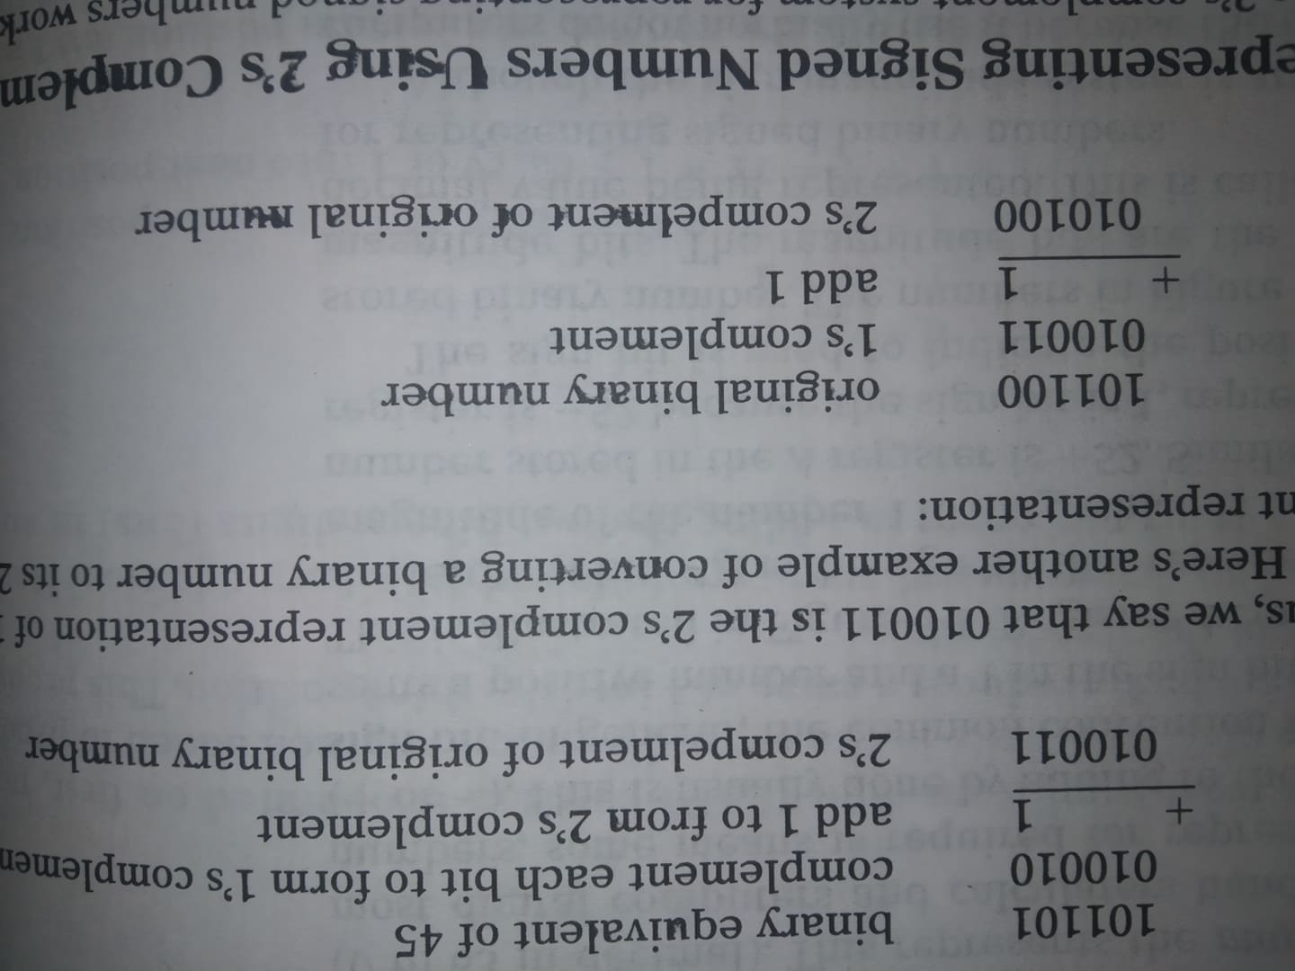
2’s complement form
The 2’s complement of a binary number is formed by taking the 1’s complement of the number and adding 1 to the LSB position.

Slide 20
Representing signed number using 2’s complement
Convert +45₁₀ in its true binary form.
If the number is negative -45, then how can you represent this?
Note: 2’s complement represents signed numbers. It allows us to perform the operation of subtraction by accurately performing addition. This is significant because it means that a digital computer can use the same circuitry both to add and to subtract, thereby analyzing a saving in hardware.

Slide 21
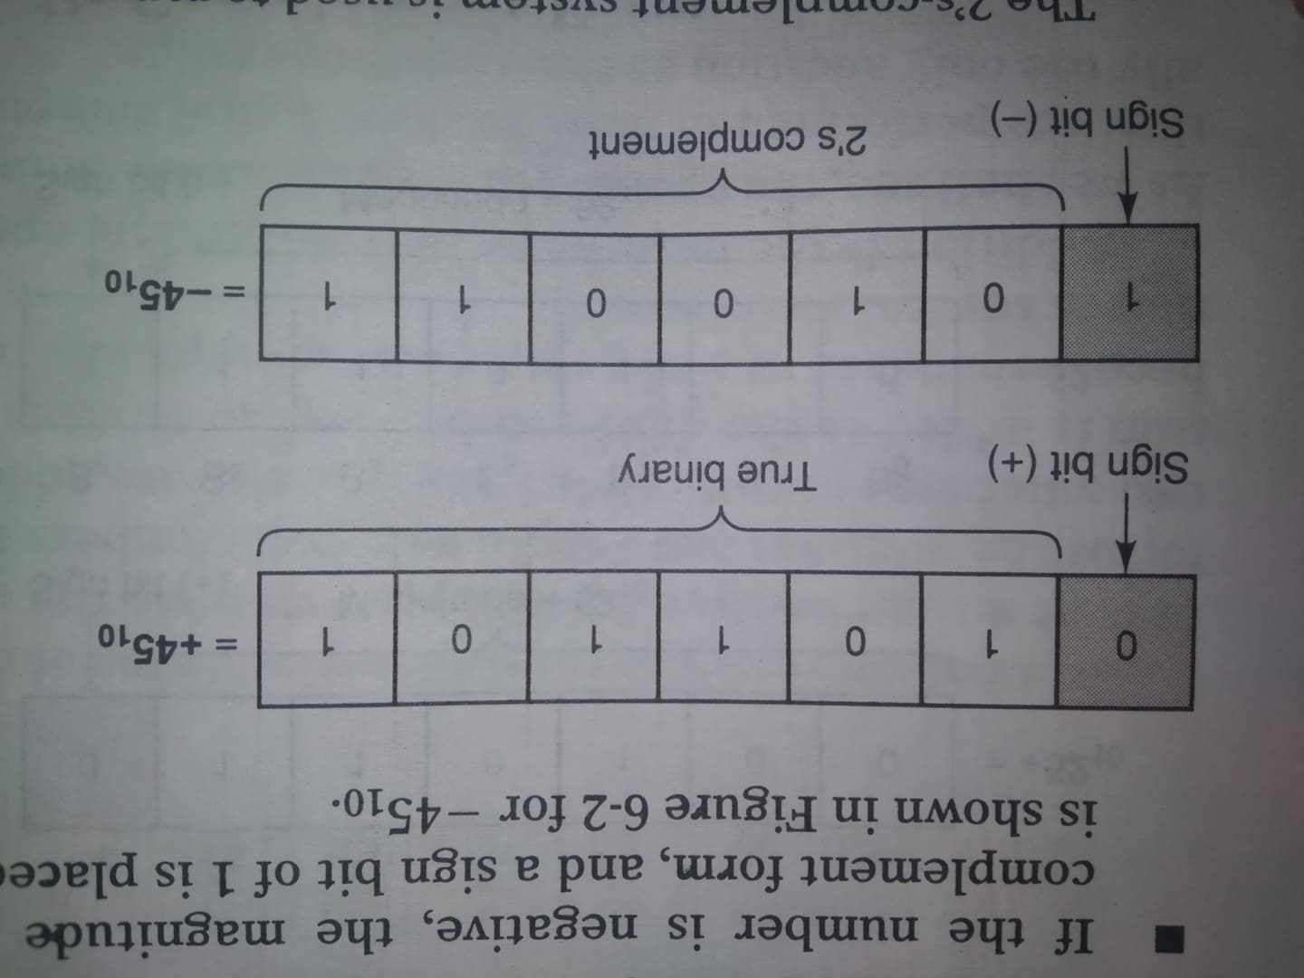
Representing signed number using 2’s complement

Slide 22
Example (homework)
+13
-9
+3
-2
-8

Slide 23
Sign extension
The size of the register (FFs no.) determines the number of binary digits. Registers size is the even multiple of 4 bits. The storage registers will be made up of 4, 8, 12, 16, 32 or 64.
For example, if we need to store a positive 5 bit number in a 8 bit register, it make sense to simply add leading zeros.

Slide 24
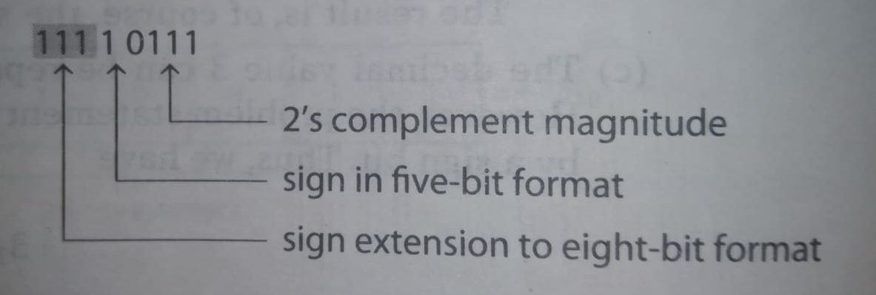
Sign extension
+9 = 000 0 1001(in 8 bit register)
-9 = 1 0111 (5 bit representation)
-9 = ?? (in 8 bit register)

Slide 25
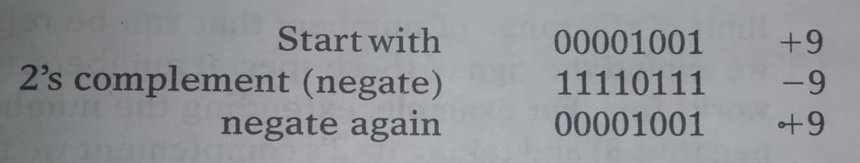
Negation
We negate a signed binary number by 2’s complementing it.

Slide 26
Example:
Each of the following numbers is a five bit signed binary number in the 2’s 2’s complement system. Determine the decimal value in each case.
1 1010
1 0001

Slide 27
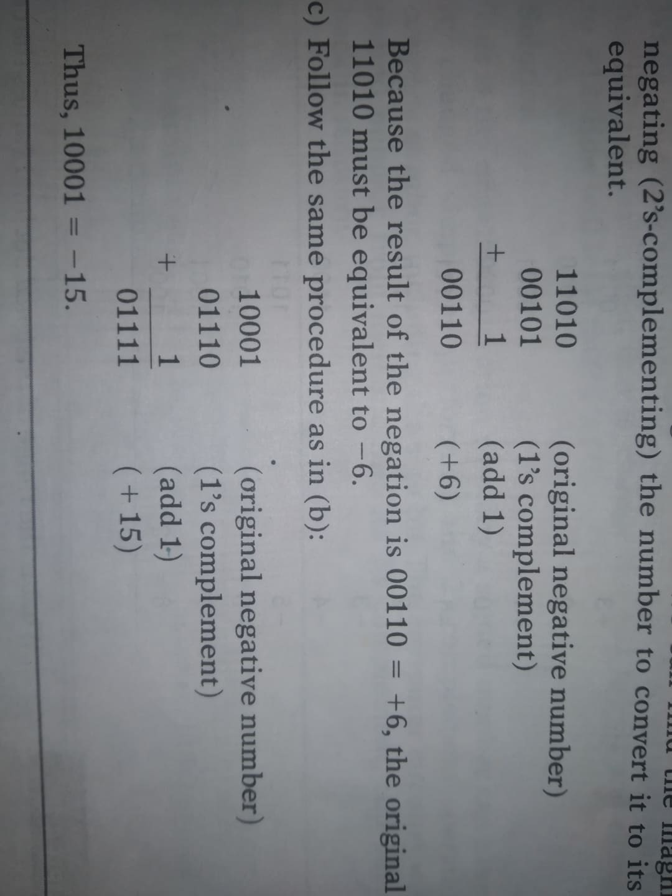
Example:

Slide 28
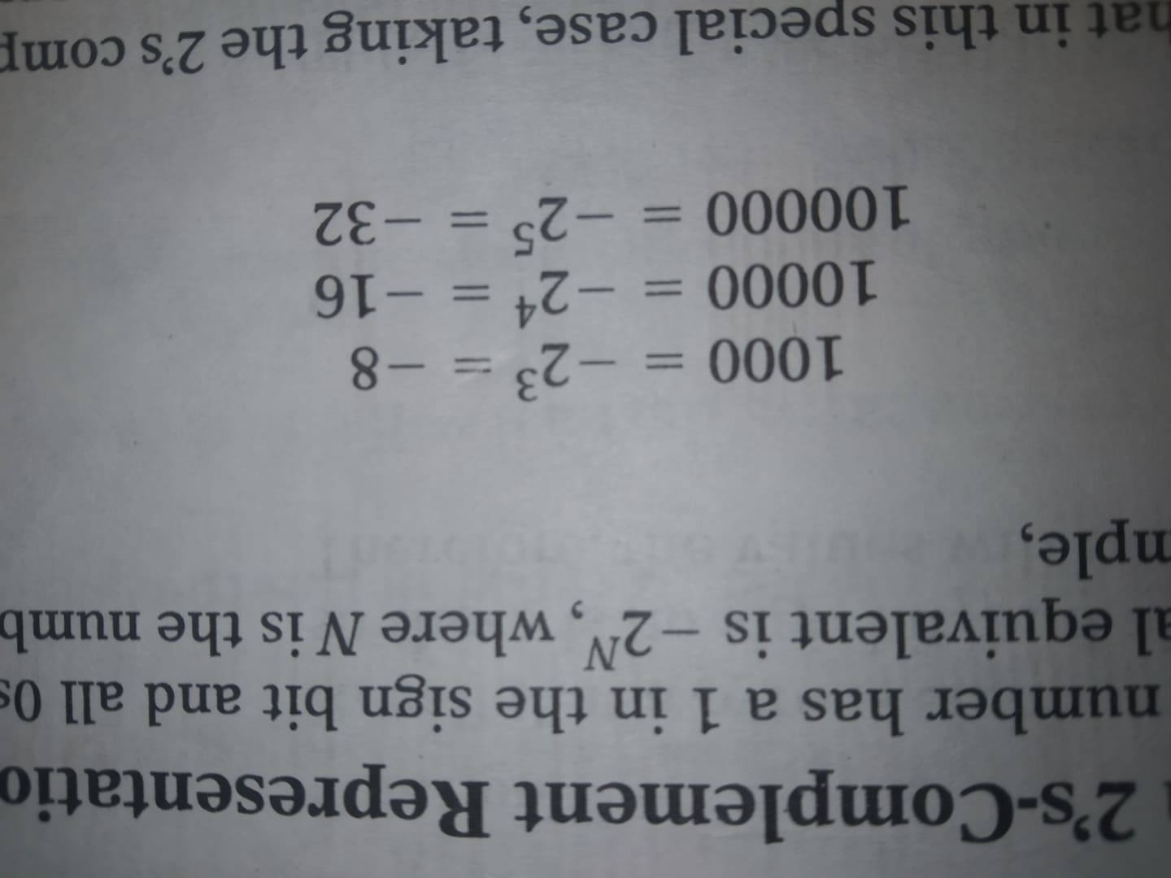
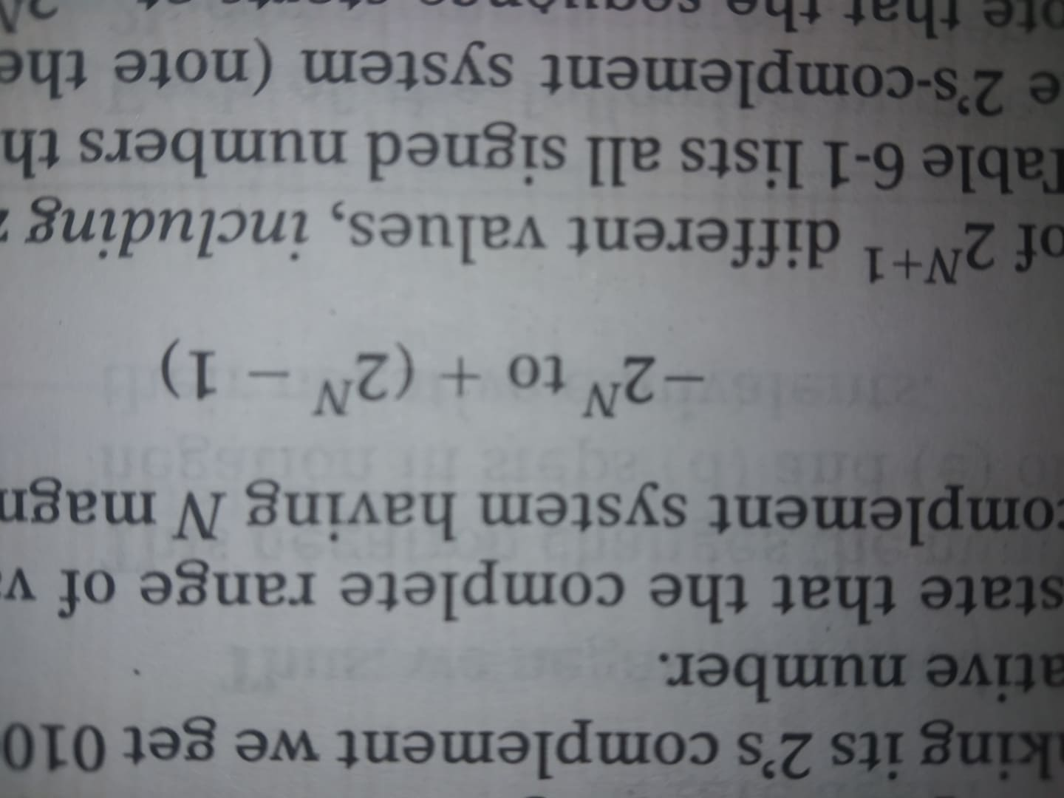

Special case in 2’s complement:
Whenever a signed number has a 1 in the sign bit and all 0s for the magnitude bits , its decimal equivalent is -$2^{N}$, where N is the number of bits in the magnitude. For example-
The complete range of values that can be represented in the 2’s
Complement system having N magnitude bits is

Slide 29
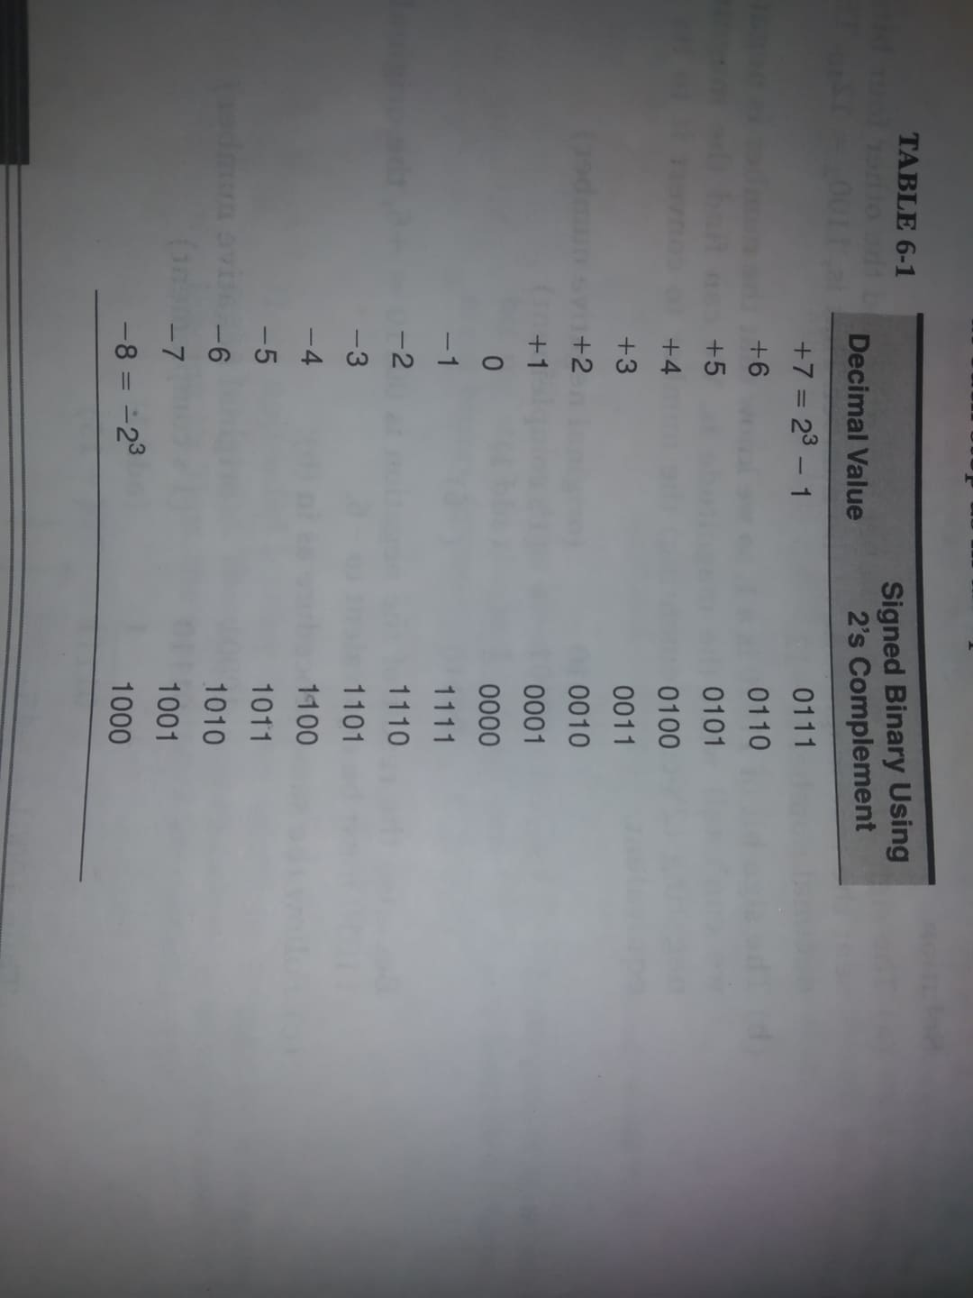
Special case in 2’s complement

Slide 30
Addition in 2’s complement

Slide 31
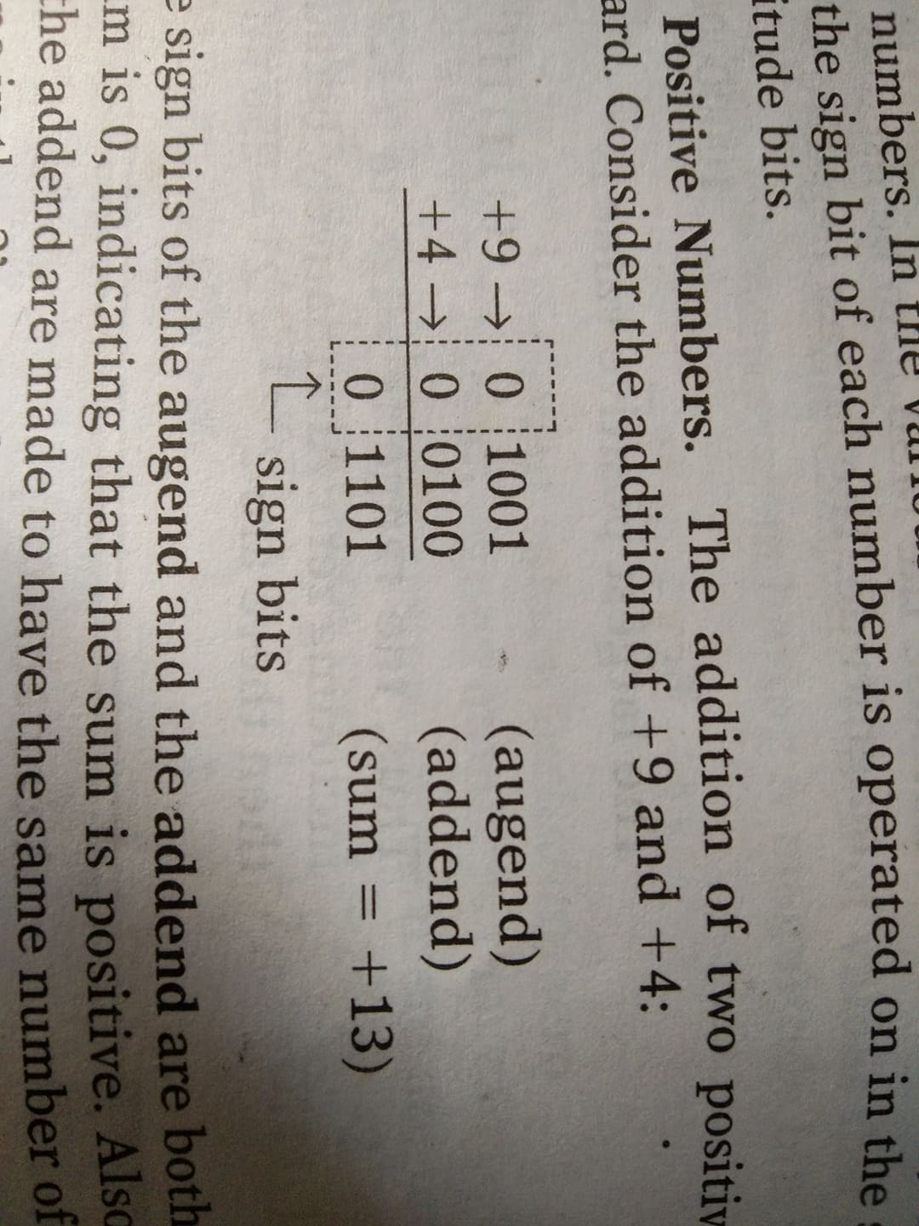
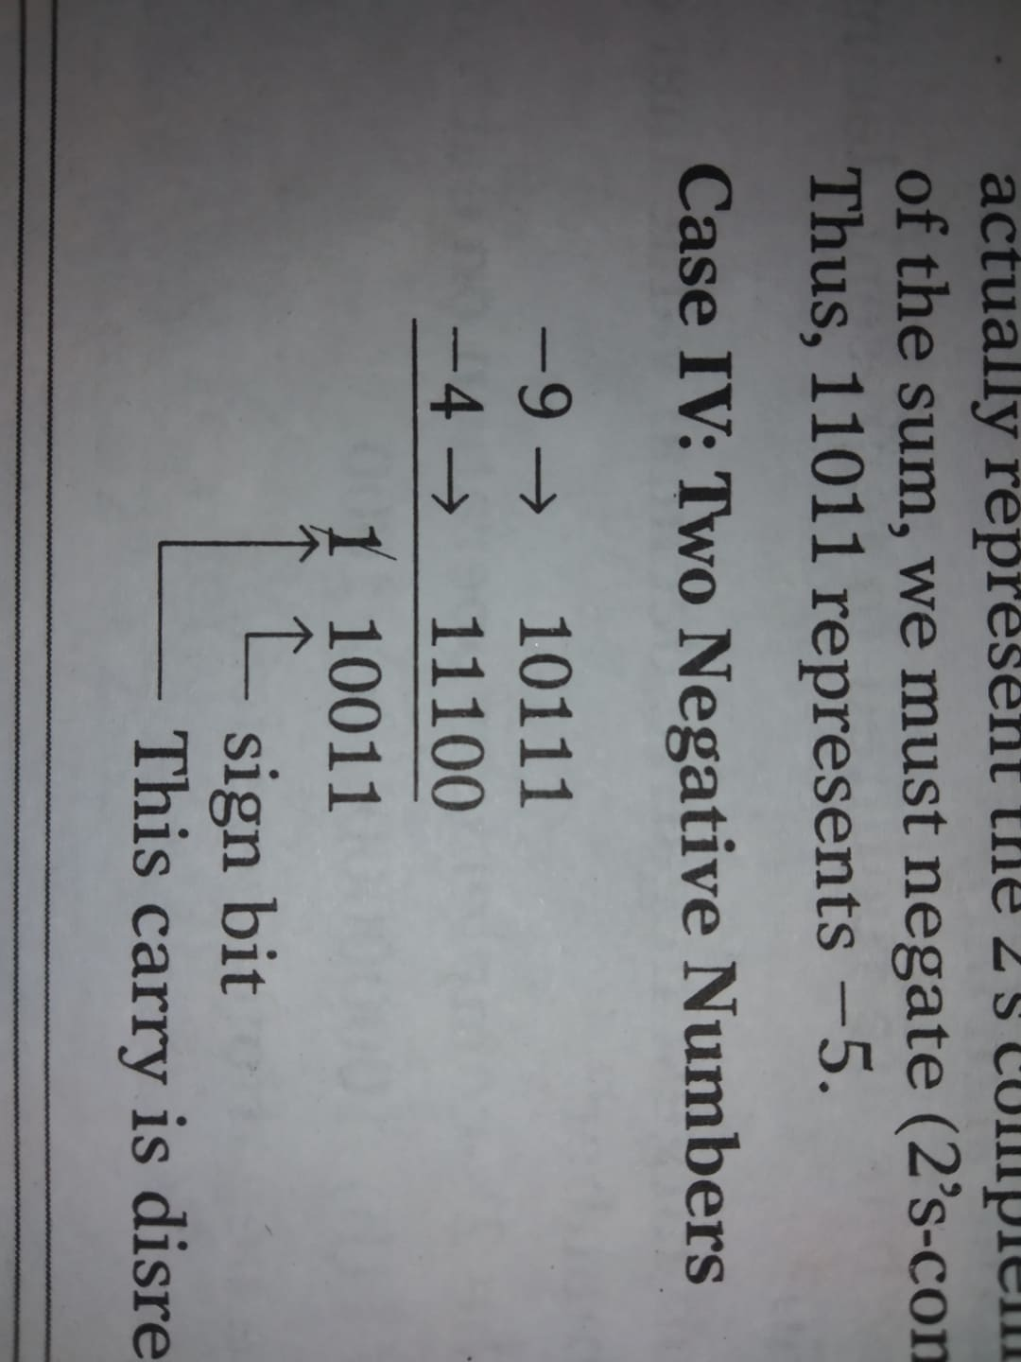
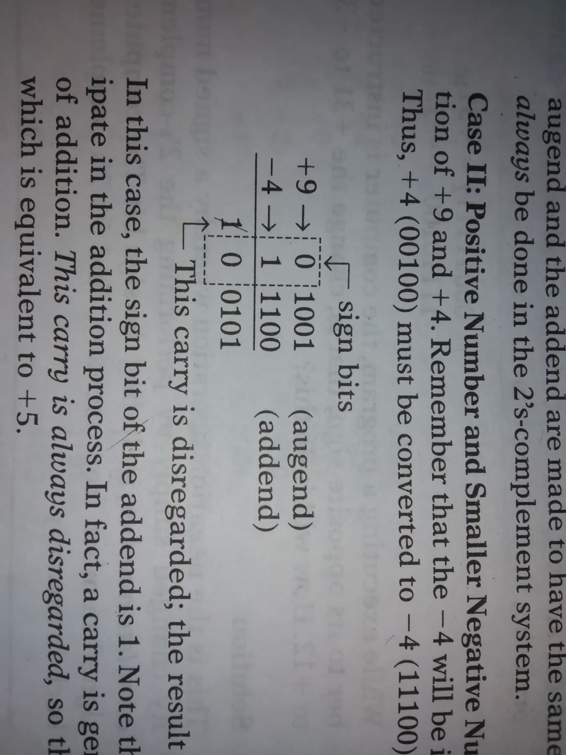
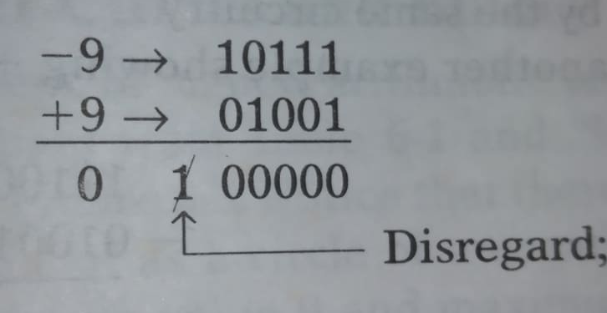
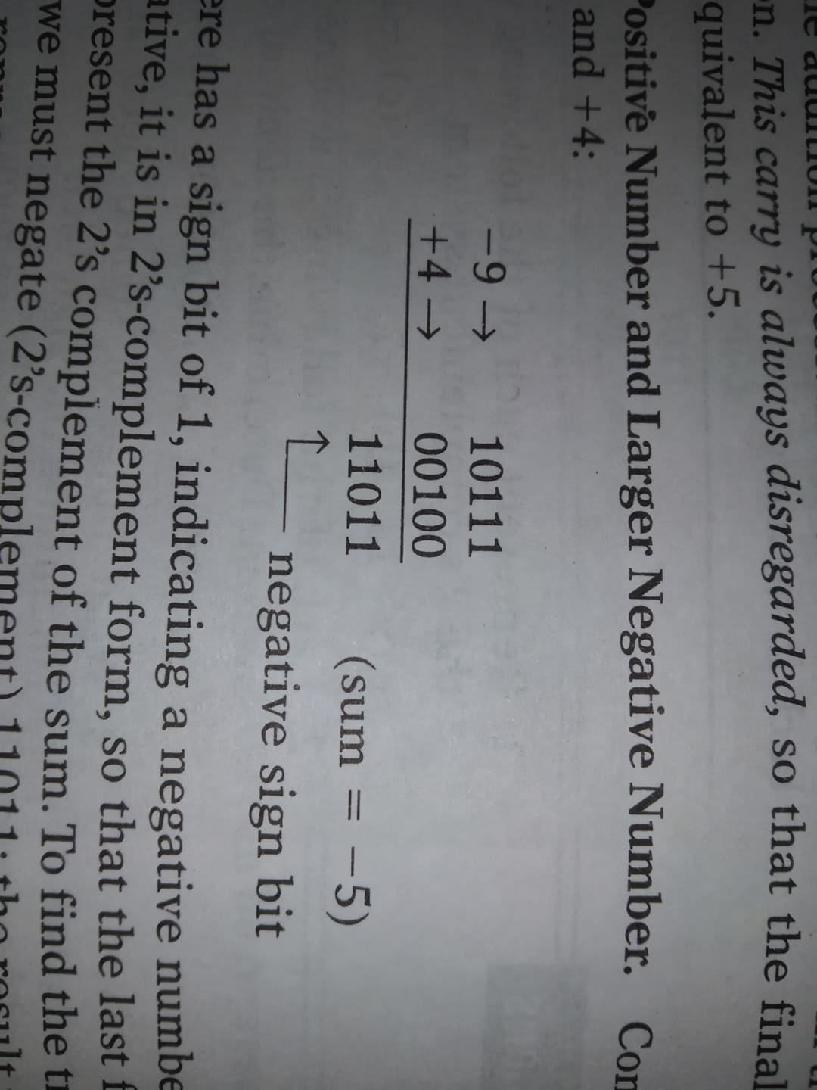
Addition in 2’s complement
1. Two positive numbers 2. Positive number and smaller negative number 3. Positive number and larger negative number 4. two negative numbers 5. equal and opposite number

Slide 32
Subtraction in 2’s complement

Slide 33
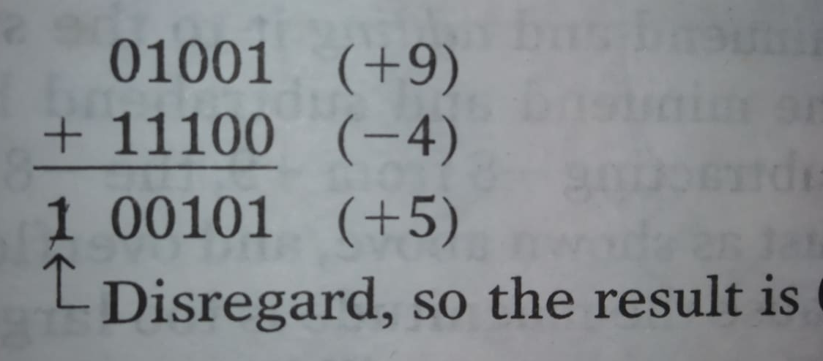
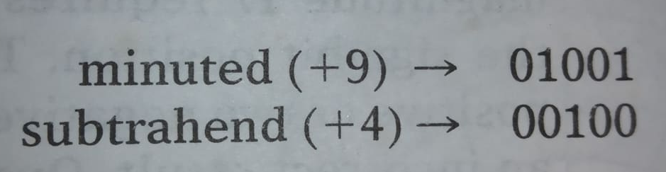
Subtraction in 2’s complement
Procedure: 1. Negate the subtrahend 2. Add this to the minuend

Slide 34
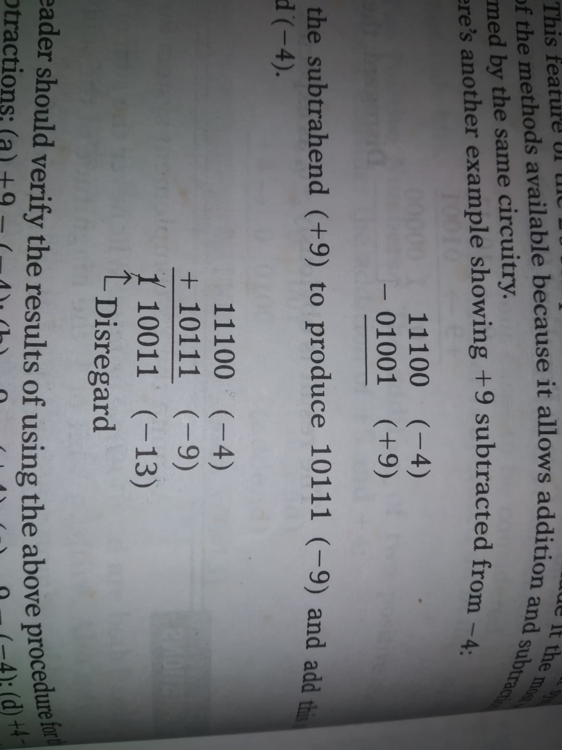
Subtraction in 2’s complement
Procedure: 1. Negate the subtrahend 2. Add this to the minuend

Slide 35
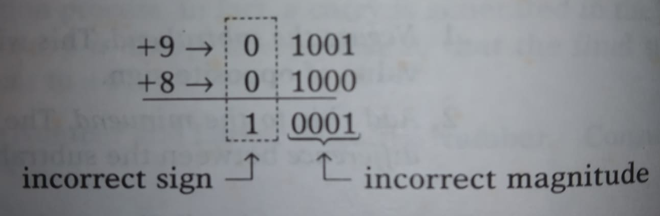
Arithmetic overflow
Overflow into the sign bit position. This overflow condition can occur when two positive or two negative numbers are being added and it always produces an incorrect result. For 2’s complement subtraction overflow can occur when minuend and subtrahend have different sign. Computer will have special circuit to detect any overflow condition.

Slide 36
Bcd addition

Slide 37
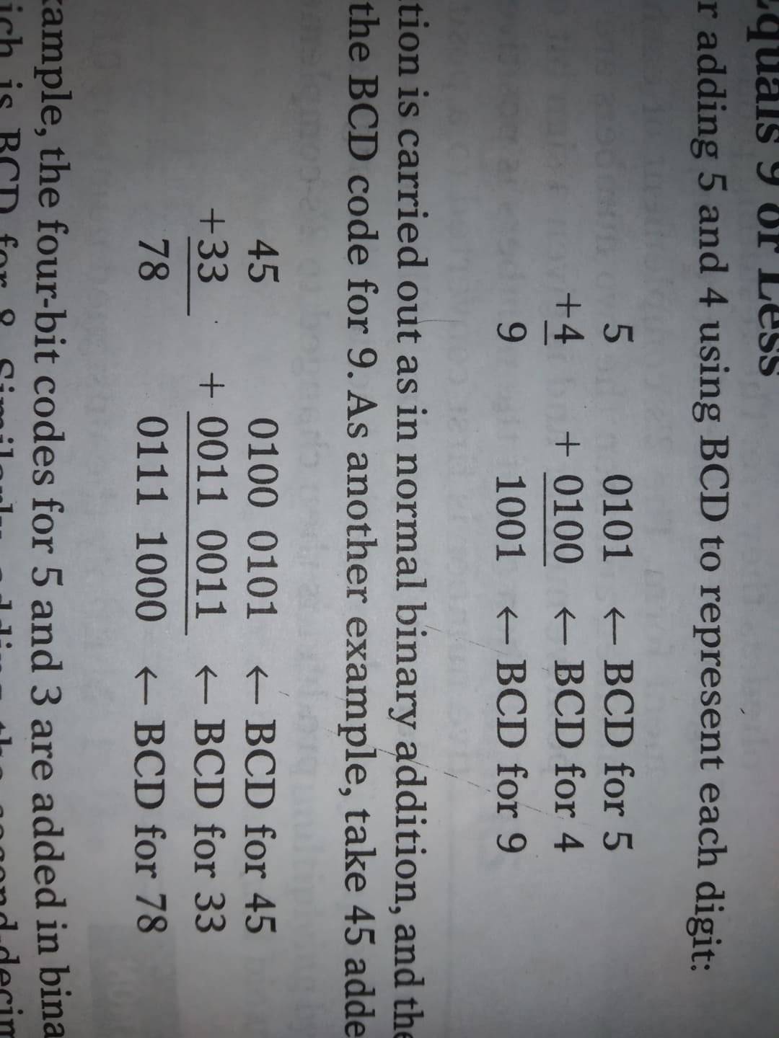
BCD Addition
1. Sum equals to 9 or less

Slide 38
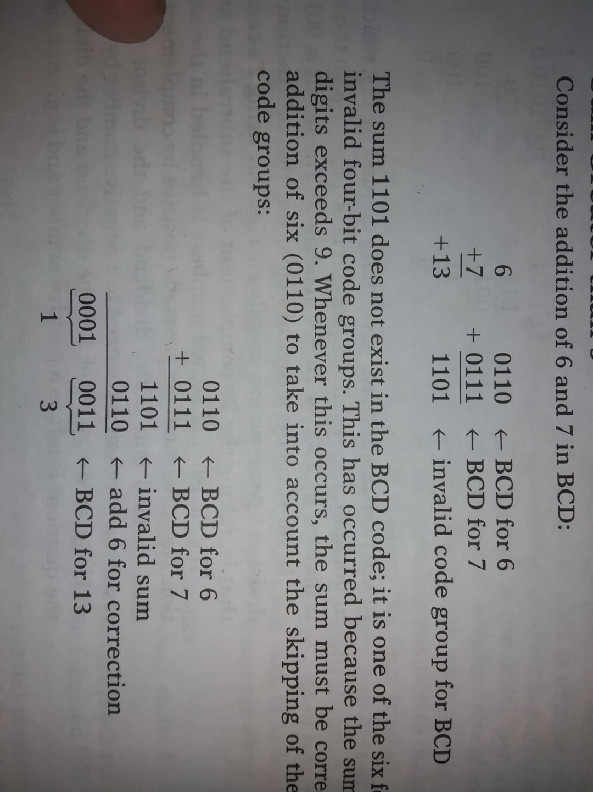
BCD Addition (correction)
2. sum greater than 9
3. Correction

Slide 39
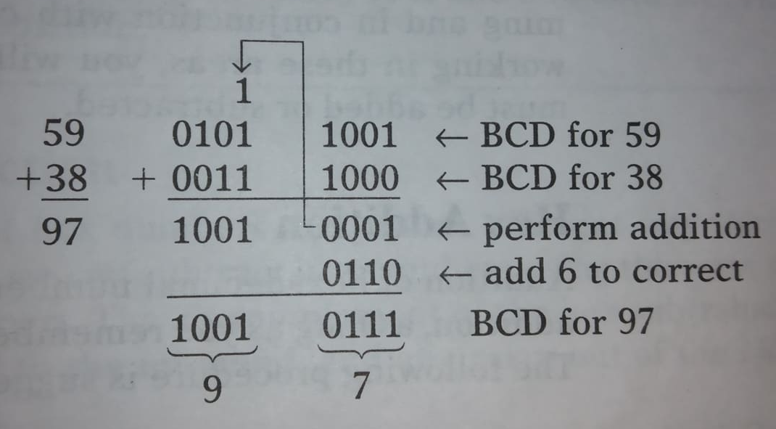
BCD Addition (correction)
2. sum greater than 9
3. Correction

